Slide 1
Global and Local Thresholding
By
Abhinaba Chowdhury
Abhiroop Mukherjee
Debarghya Dey
Jyotiprakash Roy
Shrutanten

Slide 2
1.) What is thresholding?
In digital image processing, thresholding is the simplest method of segmenting images. Image segmentation is the process of partitioning a digital image into multiple segments (sets of pixels, also known as image objects). The goal of segmentation is to simplify and/or change the representation of an image into something that is more meaningful and easier to analyze. The simplest thresholding methods replace each pixel in an image with a black pixel if the image intensity is less than some fixed constant, or a white pixel if the image intensity is greater than that constant.

Slide 3
1 cont.) Otsu’s thresholding method
Otsu's method, named after Nobuyuki Otsu (大津展之, Ōtsu Nobuyuki), is used to perform automatic image thresholding. In the simplest form, the algorithm returns a single intensity threshold that separate pixels into two classes, foreground and background. This threshold is determined by minimizing intra-class intensity variance, or equivalently, by maximizing inter-class variance.

Slide 4
1 cont.) Otsu’s thresholding method
function otsu_threshold(image): # this is the required function
for t from 1 to 255:
v1(t) = sum of variance of the first half of the histogram for threshold t
v2(t) = sum of variance of the second half of the histogram for threshold t
q1(t) = sum of probabilities of each color in first half for threshold t
q2(t) = sum of probabilities of each color in second half for threshold t
fn(t) = v1(t)*q1(t) + v2(t)*q2(t)
if fn(t) is the minimum value of fn yet:
fn = fn(t)
save t
return t

Slide 5
1 cont.) Otsu’s thresholding method
We need to find the value of color (t) for which we can divide the histogram of a bimodal images into two halves, each containing one peak
So we need to find the minimum t for which fn(t) = v1(t)*q1(t) + v2(t)*q2(t) is minimum, where
v1 = sum of variance of the first half of the histogram
v2 = sum of variance of the second half of the histogram
q1 = sum of probabilities of each color in first half
q2 = sum of probabilities of each color in second half
to do this, we run a loop, varying t from 1 to 255:
we calculate v1(t),q1(t),v2(t),q2(t)
then we find fn(t) = v1(t)*q1(t) + v2(t)*q2(t)
if fn(t) is the minimum value of fn yet:
fn = fn(t)
save t
after the loop we will have t, which will divide the histogram
of the bimodal image into two parts.
we can use t as a threshold to make any value greater that t to
255 (black) and make other color to 0 (white)

Slide 6
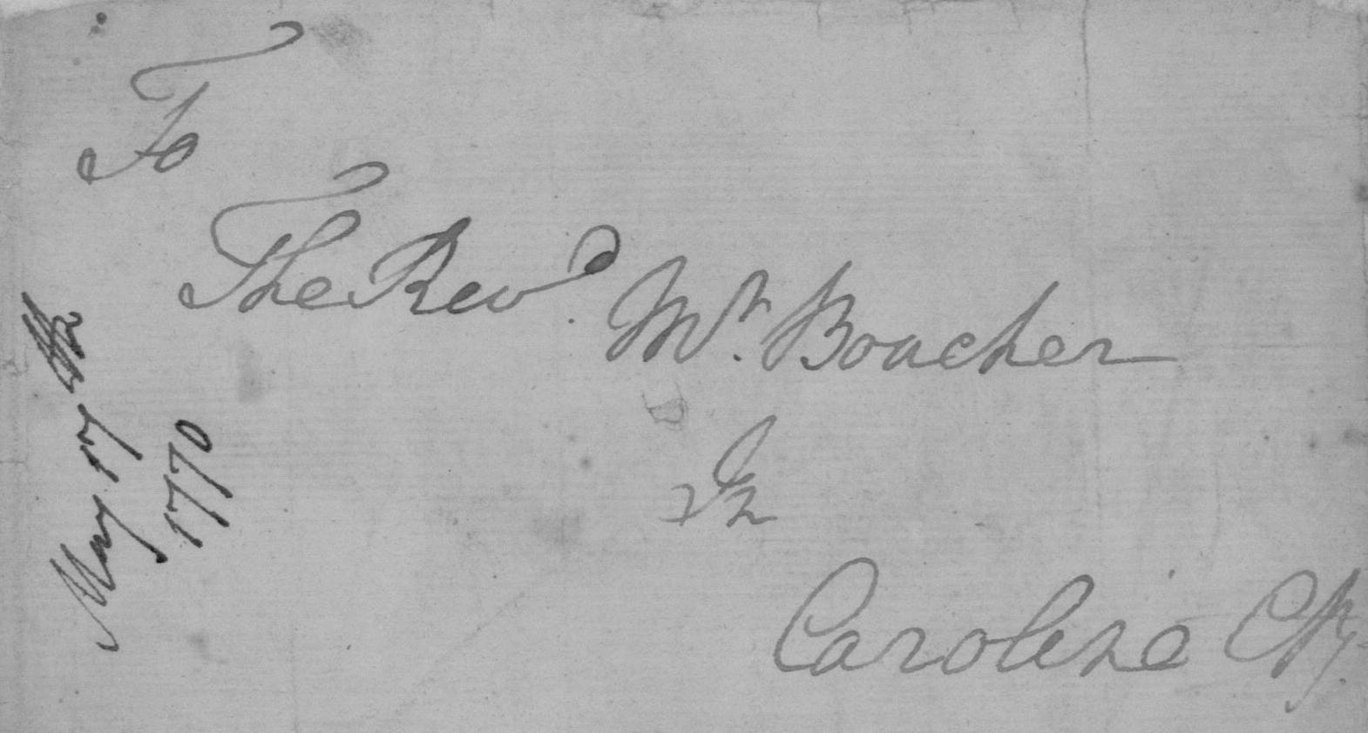
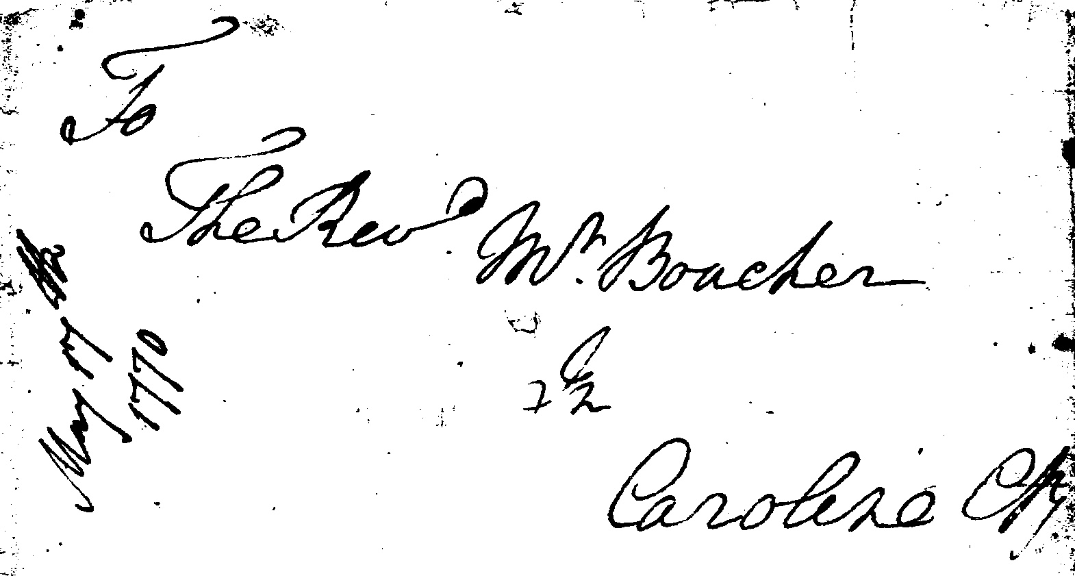
1 cont.) Otsu’s thresholding method - Outputs
Original Image
Image produced by the algorithm

Slide 7
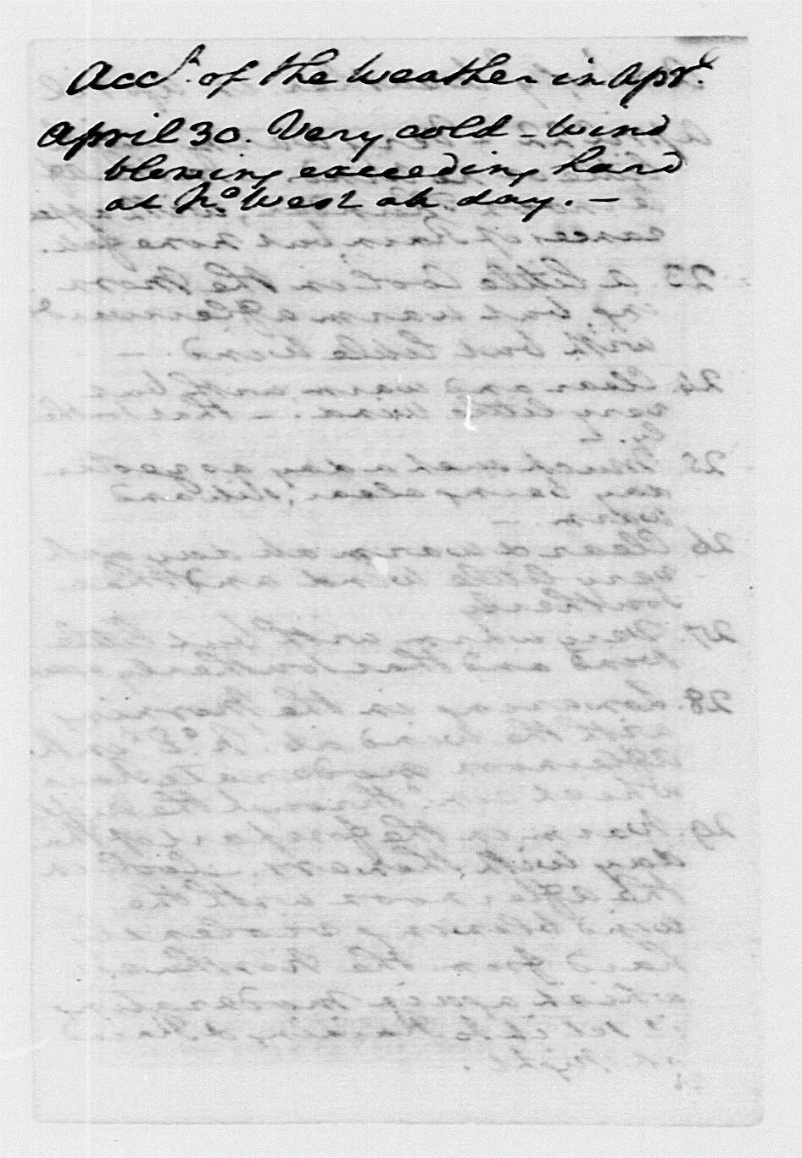

1 cont.) Otsu’s thresholding method - Outputs
Original Image
Image produced by the algorithm

Slide 8
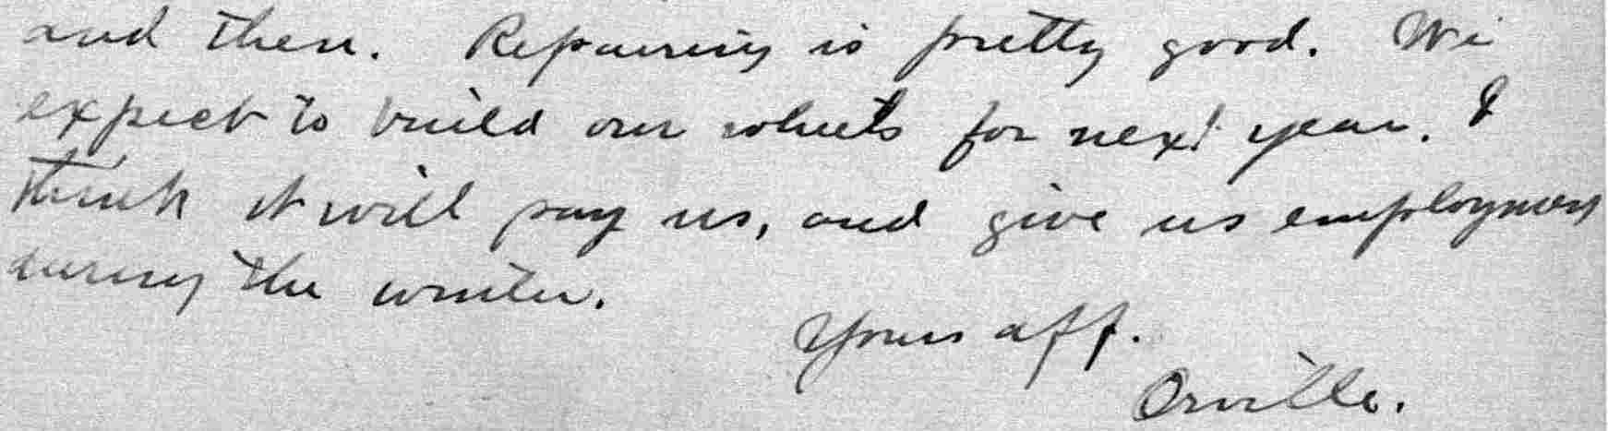
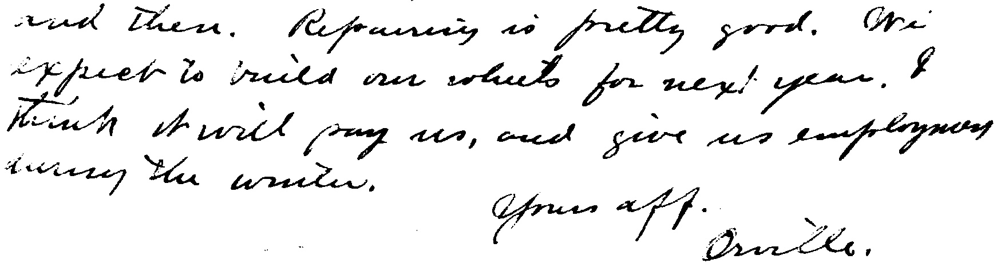
1 cont.) Otsu’s thresholding method - Outputs
Original Image
Image produced by the algorithm

Slide 9
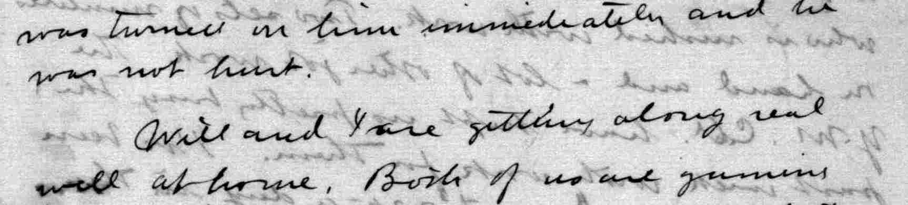
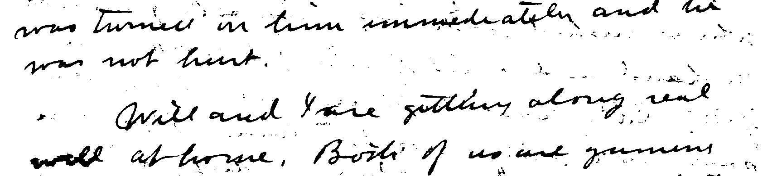
1 cont.) Otsu’s thresholding method - Outputs
Original Image
Image produced by the algorithm

Slide 10
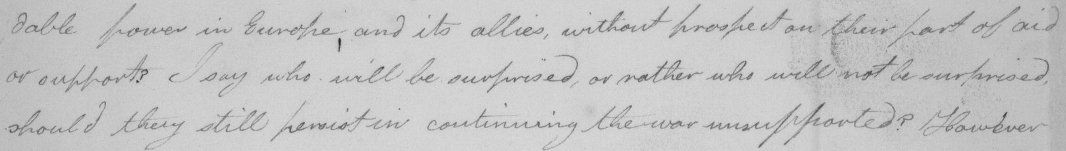
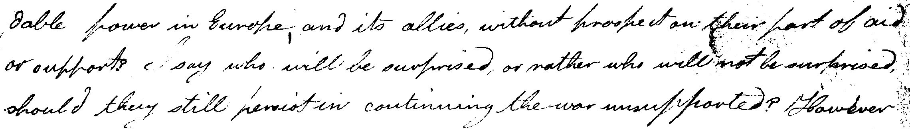
1 cont.) Otsu’s thresholding method - Outputs
Original Image
Image produced by the algorithm

Slide 11

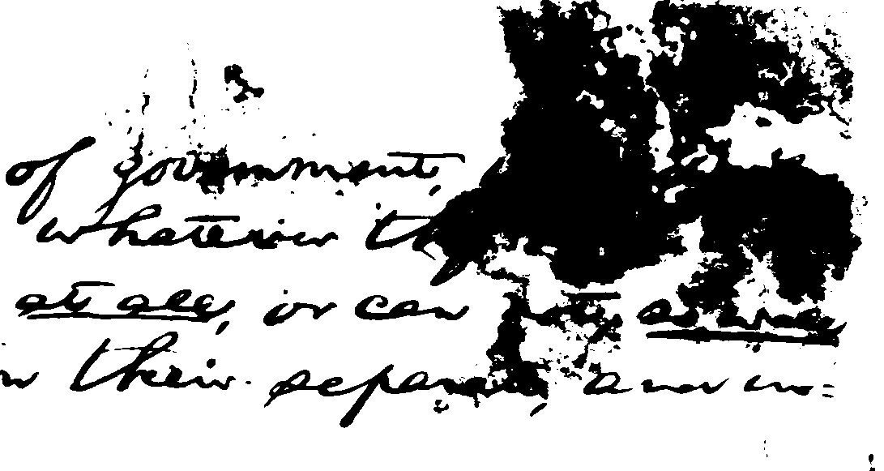
1 cont.) Otsu’s thresholding method - Outputs
Original Image
Image produced by the algorithm

Slide 12
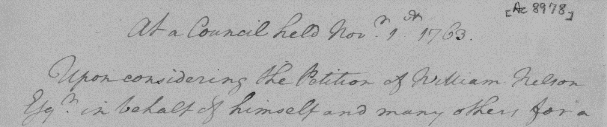
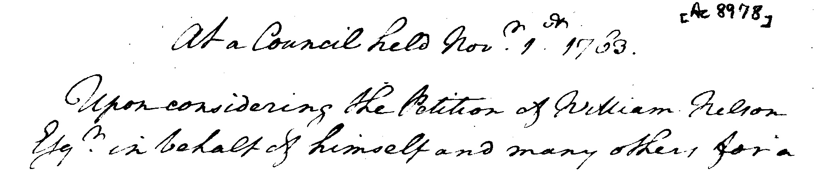
1 cont.) Otsu’s thresholding method - Outputs
Original Image
Image produced by the algorithm

Slide 13
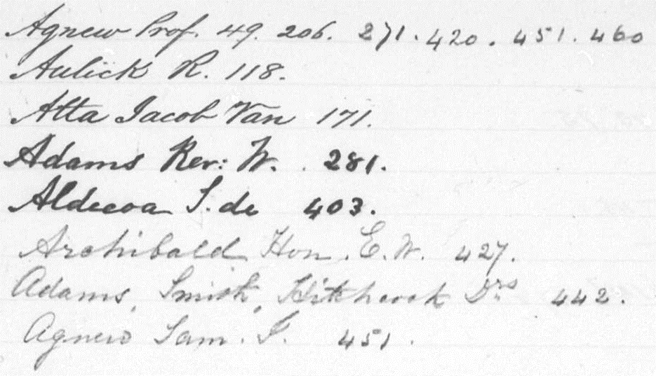
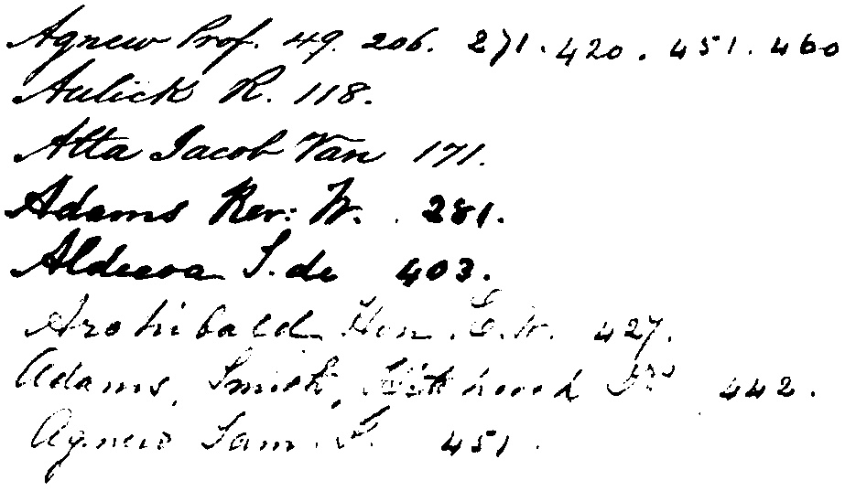
1 cont.) Otsu’s thresholding method - Outputs
Original Image
Image produced by the algorithm

Slide 14
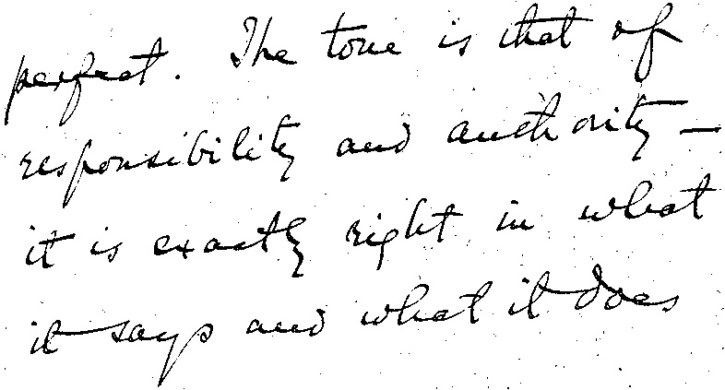
1 cont.) Otsu’s thresholding method - Outputs
Original Image
Image produced by the algorithm

Slide 15
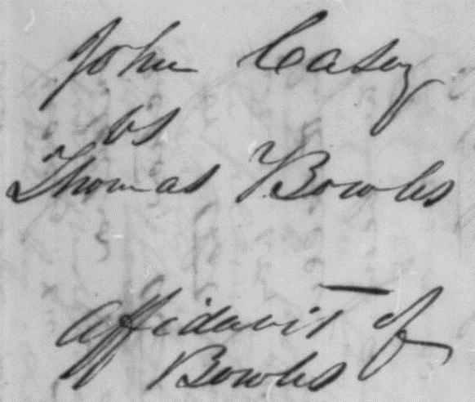
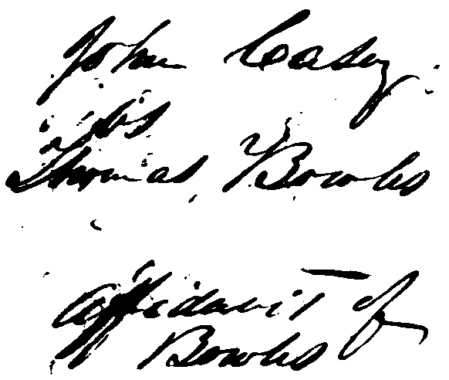
1 cont.) Otsu’s thresholding method - Outputs
Original Image
Image produced by the algorithm

